Slide 1
Patterns of Reasoning: Abduction.
Created by Dmytro Nasikan
Group DA-92

Slide 2
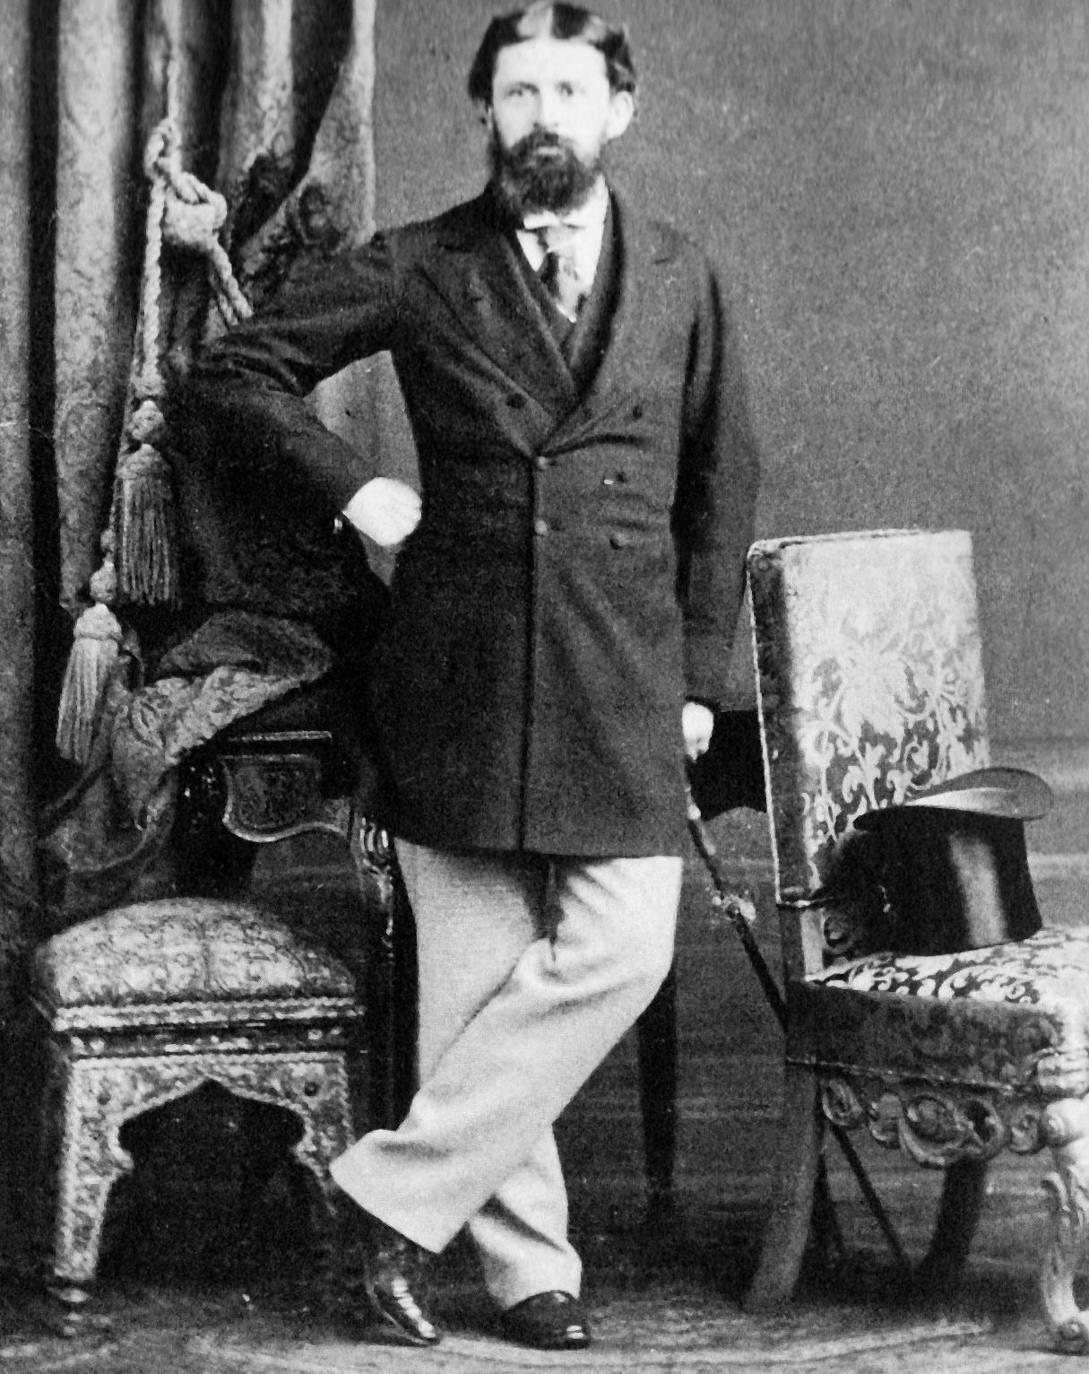
What is abduction?
Abductive reasoning is a form of logical inference formulated and advanced by American philosopher Charles Sanders Peirce beginning in the last third of the 19th century. It starts with an observation or set of observations and then seeks to find the simplest and most likely conclusion from the observations.

Slide 3
Abduction is no more nor less than guessing
Charles Sanders Pierce (1839-1914)

Slide 4
Simple explanation of abduction
Abductive reasoning is most easily understood through the analogy of a doctor diagnosing his patient’s illness. He gathers a hypothesis from the patient’s symptoms, or otherwise evidence that he deems factual, and from there, goes down the list of maladies and tries to assign the appropriate illness. This is as opposed to deductive or inductive reasoning.

Slide 5
Why is abductive inference useful?
”Abduction works often enough and is the only source for new ideas.”
It has been shown that abductive reasoning plays a key role in design as it is the only logical operation that introduces new ideas.

Slide 6
Example 1
When Newton saw the apple falling down, he must have done an abductive inference and came up with the theory of gravity.
1) A possible Thought Process Apple fell down.
2) If earth pulled everything towards it, then of course, apple too would fall down.
3) So earth is pulling everything towards it.

Slide 7
Example 2
When it rains, the grass gets wet.
The grass is wet, it must have rained.

Slide 8
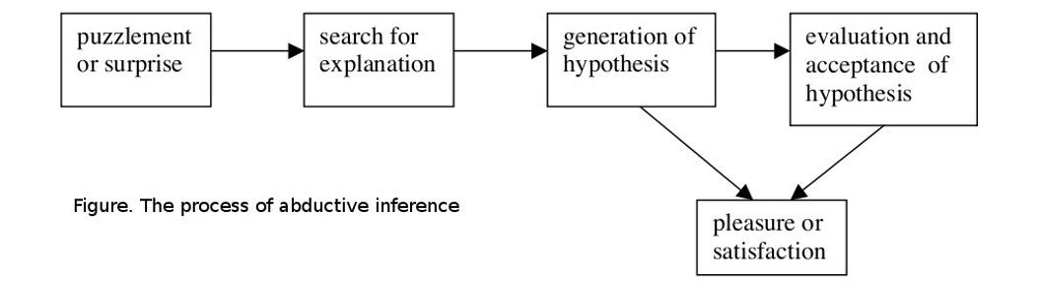
Stages in Mental Process of Abduction

Slide 9
Abductive Reasoning Process Model
Set-Cover Based
Defining a theory from a set of hypotheses based on the current observations.
Logic Based
Defining a logical theory based on a set of sentences (explanations) that describe the observations.

Slide 10
Power of Abduction
”Abduction is not a feeble-minded cousin of deductive principles like modus ponens. Its actually, a far richer and more powerful form of thinking”.
People's understanding of causality is inherently non-verbal because it is rooted in visual and kinesthetic perception.

Slide 11
Applications of Abduction in Real-Life
Domains | Targets to be Explanained | Explanatory hypothesis
Science | Experimental Results | Theories
Medicine | Symtoms | Diseases
Crime | Evidence | Culprits and Motives
Machines | Operations, Breakdowns | Parts, Interactions and Flaws
Social | Behaviour | Mental States and Traits

Slide 12
Applications in AI
Applications in artificial intelligence include fault diagnosis, belief revision, and automated planning. The most direct application of abduction is that of automatically detecting faults in systems: given a theory relating faults with their effects and a set of observed effects, abduction can be used to derive sets of faults that are likely to be the cause of the problem.

Slide 13
Thanks for your attention
Created by Dmytro Nasikan

